Slide 1
Audio Parameters: timing, scheduling, envelopes…

Slide 2
Automation in audio production
Having the Digital Audio Workstation do some tasks for you
Assigning automation curves to change fader levels

Slide 3
Parameters and timing
Each Audio Parameter can be changed by;
setting it
connecting a node to it
Everything connected to a parameter adds to its value
scheduling events
Parameter has list of events, initially empty, defining when and how values change
Timeline-based automation curves allow us to schedule changes at precise times
Tone.frequency.value = 200;
gainNode.connect(Tone.frequency);

Slide 4
Parameter scheduling
SetValueAtTime instantaneous change to value at startTime
LinearRampToValueAtTime linear change from previous to new value at endTime
exponentialRampToValueAtTime exponential change starting at previous event time, ramp to value at endTime
Can’t set start or end value to zero
setTargetAtTime At startTime, exponentially move toward target at rate given by timeConstant
setValueCurveAtTime Follow array of values, scaled to fit interval starting at startTime and spanning a given duration

Slide 5
Comparing curves
LinearRampToValueAtTime linear change from previous to new value at endTime
param.linearRampToValueAtTime(value, endTime)
exponentialRampToValueAtTime exponential change from previous to new value at endTime
param.exponentialRampToValueAtTime(value, endTime)
setTargetAtTime At startTime, exponentially move toward target at rate given by timeConstant
param.setTargetAtTime(target, startTime, timeConstant)
now=context.currentTime
linearRampToValueAtTime(2, 1+now)
exponentialRampToValueAtTime(2, 1+now)
setTargetAtTime(2, now, 0.5)

Slide 6
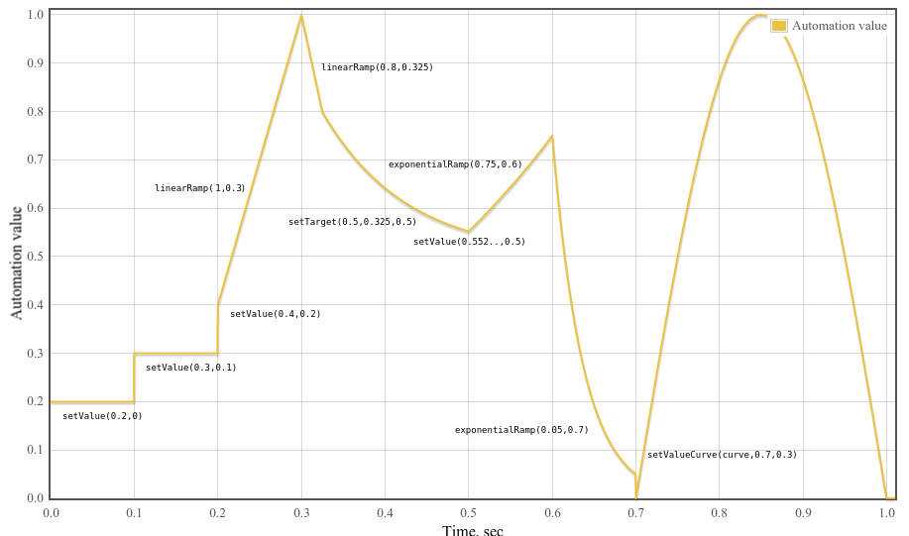
Example
for (i=0;i<1000;++i)
curve[i] = Math.sin(Math.PI*i/1000);
var t0=0,t1=0.1,t2=0.2,t3=0.3,t4=0.325;
var t5=0.5,t6=0.6,t7=0.7,t8=1;
var v5,timeConstant = 0.1;
p.setValueAtTime(0.2, t0);
p.setValueAtTime(0.3, t1);
p.setValueAtTime(0.4, t2);
p.linearRampToValueAtTime(1, t3);
p.linearRampToValueAtTime(0.8, t4);
p.setTargetAtTime(.5, t4, timeConst);
// Find setTargetAtTime at t5 so no
// discontinuity.
v5=0.5+(0.8-0.5)*Math.exp((t4-t5)/timeConst);
p.setValueAtTime(v5,t5);
p.exponentialRampToValueAtTime(0.75,t6);
p.exponentialRampToValueAtTime(0.05,t7);
p.setValueCurveAtTime(curve,t7,t8-t7);

Slide 7
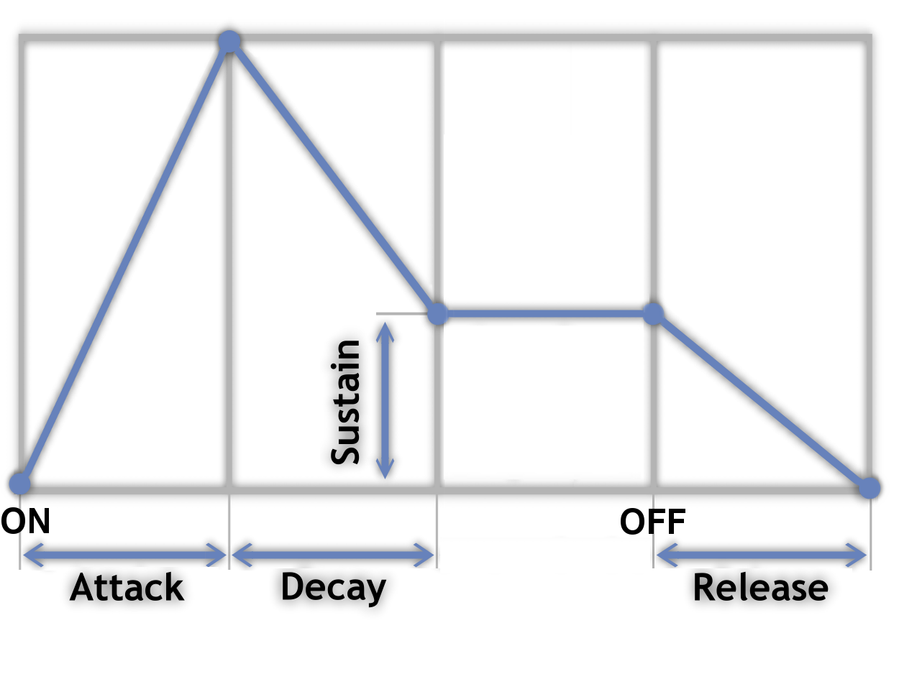
ADSR Curves
Attack, Decay, Sustain, Release
Means of controlling a waveform’s amplitude, or other parameter
Attack, Decay and Release are values of time
Sustain is a value of intensity
Demo - http://mohayonao.github.io/adsr-envelope/

Slide 8
Beep!
<input type="button" value="Beep" id="triggerBeep">
<p>Frequency</p>
<input type="number" id="Frequency" min=0 max=8000 value=440>
<p>Attack</p>
<input type="number" id="Attack" min=0 max=1000 value=50>
<p>Decay</p>
<input type="number" id="Decay" min=0 max=1000 value=50>
<script src="Beep.js"></script>
Burst of sawtooth wave
Ramp up to 1 and back down again
Timing in WAA is in seconds, not milliseconds
var context = new AudioContext();
var Volume = new GainNode(context,{gain:0});
var Tone = new OscillatorNode(context,{type:'sawtooth'});
Tone.connect(Volume);
Volume.connect(context.destination);
Tone.start();
triggerBeep.onclick = function() {
context.resume()
let now = context.currentTime;
Tone.frequency.value = Frequency.value;
Volume.gain.setValueAtTime(0.0, now);
Volume.gain.linearRampToValueAtTime(1,now + Attack.value/1000);
Volume.gain.linearRampToValueAtTime(0,now + Attack.value/1000 + Decay.value/1000);
}

Slide 9
Repeat beep
<input type="button" value="Repeat beep" id="triggerBeep">
<script>
var context = new AudioContext();
var Attack=100,Decay=100;
var Volume = new GainNode(context,{gain:0});
var Tone = new OscillatorNode(context);
Tone.connect(Volume).connect(context.destination);
Tone.start();
triggerBeep.onclick = function() {
context.resume()
var interval = setInterval(function(){
let now = context.currentTime;
Volume.gain.setValueAtTime(0.0, now);
Volume.gain.linearRampToValueAtTime(1, now + Attack/1000);
Volume.gain.linearRampToValueAtTime(0, now + Attack/1000 + Decay/1000);
},1000);
}
</script>
Use setInterval()
Repeats a function every specified time
Uses milliseconds, not part of the WAA
Call clearInterval() to stop it
Use setTimeout() to call a function just once

Slide 10
setValueCurveAtTime
<input type="button" value="Beep" id="triggerBeep">
<p>Frequency</p>
<input type="number" id="Frequency" min=0 max=8000 value=440>
<p>Duration</p>
<input type="number" id="Duration" min=0 max=1000 value=50>
<script src="SetValueCurve.js"></script>
Value curve is a floating 32 array
The parameter then moves through this curve over the specified duration
Linear interpolation between values in the array
setValueAtTime is then used to reset the parameter to zero
var context = new AudioContext();
var Volume = new GainNode(context,{gain:0});
var Tone = new OscillatorNode(context,{type:'sawtooth'});
Tone.connect(Volume);
Volume.connect(context.destination);
Tone.start();
var valueCurve = new Float32Array(100);
for (i=0;i<100;i++) valueCurve[i]=Math.sin(Math.PI*i/100);
triggerBeep.onclick = function() {
context.resume()
let now = context.currentTime;
Tone.frequency.value = Frequency.value;
Volume.gain.setValueCurveAtTime(valueCurve,now,Duration.value/1000);
Volume.gain.setValueAtTime(0,now+Duration.value/1000);
}

Slide 11
cancelScheduledValues vs cancelAndHoldAtTime
cancelScheduledValues cancels all scheduled future changes
cancelAndHoldAtTime cancels all scheduled future changes but holds its value until further changes are made
Example: ramped offset on a constant source node
var now=context.currentTime;
input.offset.value=0;
input.offset.linearRampToValueAtTime(1,now+1);
1
0
1

Slide 12
cancelScheduledValues vs cancelAndHoldAtTime
cancelScheduledValues cancels all scheduled future changes
cancelAndHoldAtTime cancels all scheduled future changes but holds its value until further changes are made
Example : ramped offset on a constant source node
var now=context.currentTime;
input.offset.value=0;
input.offset.linearRampToValueAtTime(1,now+1);
input.offset.cancelScheduledValues(now+0.5);
1
0
1

Slide 13
cancelScheduledValues vs cancelAndHoldAtTime
cancelScheduledValues cancels all scheduled future changes
cancelAndHoldAtTime cancels all scheduled future changes but holds its value until further changes are made
Example : ramped offset on a constant source node
var now=context.currentTime;
input.offset.value=0;
input.offset.linearRampToValueAtTime(1,now+1);
input.offset.cancelAndHoldAtTime(now+0.5);
1
0.5
0
0.5
1

